Slide 1
VIRTUAL LEARN ONLINE TRAINING WEBSITE
Internal Guide
Dr. Pallavi Shetty
Associate Professor
Department of MCA
NMAMIT , Nitte
Submitted by,
Deepthi Nayak
4NM20MC021
4th Sem MCA
NMAMIT, Nitte

Slide 2
Abstract
Nowadays Online education is becoming popular. It overcomes the traditional education system’s time, space, and other limitations.
Teachers and students are using the internet for accessing a vast amount of information.
The project aims to develop a website using HTML, CSS, and ReactJS framework.
It includes two parts in Frontend, the Student interface, and Admin Interface.

Slide 3
Introduction
Virtual Learning or E-learning fulfills the thirst for knowledge and offers online content that can be delivered to the learner anywhere, anytime, and age through a wide range of e-learning solutions compared with traditional learning systems.
It also provides rapid access to specific knowledge and information. Because every student is unique, it offers a learning experience that is different from that of a regular classroom

Slide 4
Scope Of The Project
The scope of this project covers the registration of students’ personal information.
Tutorial classes for each student.
The limitation of this project is the unavailability of Real-time chatting.

Slide 5
Existing System With Limitations
The current system is that lectures download references for students or for lecturing.
Students only get help from lectures if the lectures are in their office.
New lectures to a course have to get materials on their own.
Students are required to physically be in the classroom in order to gain knowledge.

Slide 6
MODULES
Student Interface
Instructor Interface

Slide 7
STUDENT INTERFACE
In the Student interface, it enables the user to access the online course.
When the user opens the website, it prompts a login screen and if the user provides a valid user name and password the website will open a Dashboard screen.
If the user does not have the account, then the user can register for a new account.
After successful login, the user can search for the course he/she is interested in.

Slide 8
INSTRUCTOR INTERFACE
The login procedure follows the same as in the student interface.
The Instructor interface enables the instructor to,
manage the course videos,
upload quizzes,
track student course involvement statistics.

Slide 9
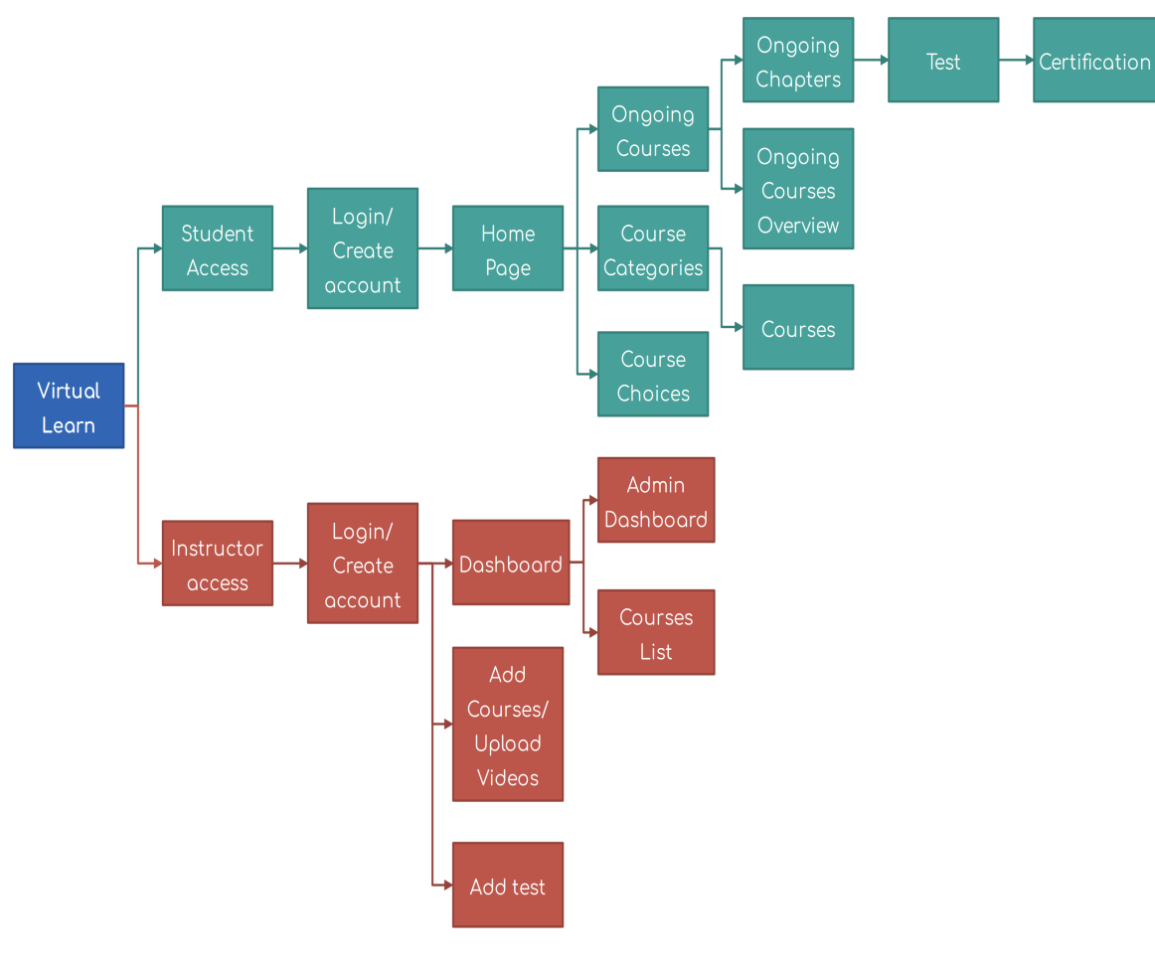
Workflow of Virtual-learning system

Slide 10
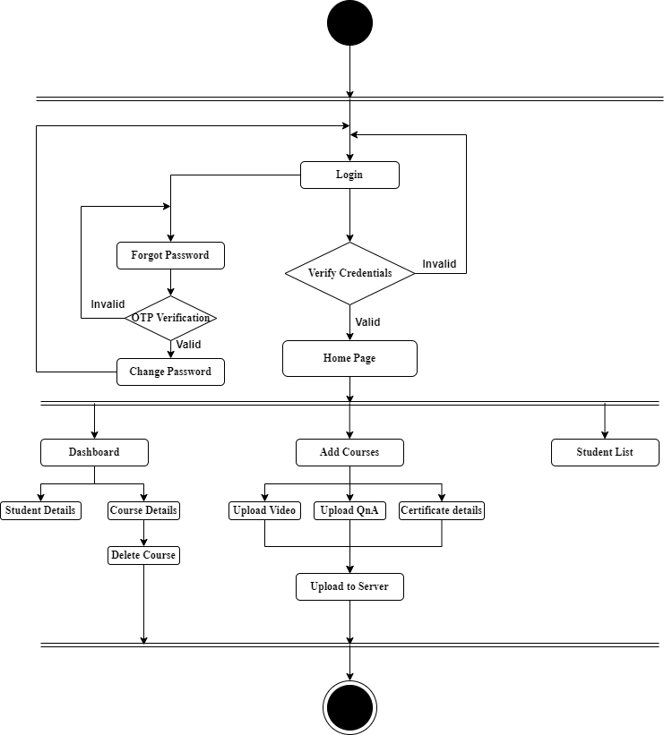
System Design
Activity Diagram(Admin)

Slide 11
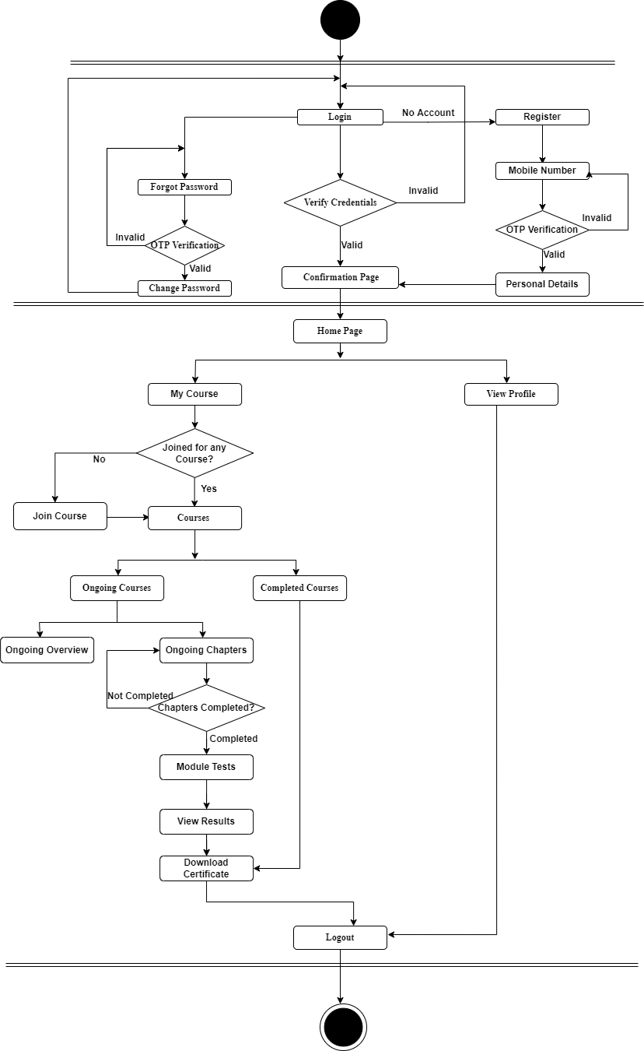
Activity Diagram(Student)
Fig 3 : activity diagram for student interface

Slide 12
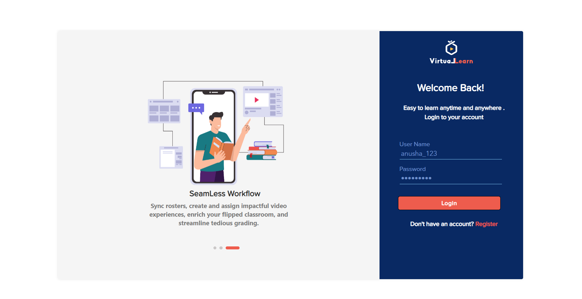
Screenshots
Student Login page

Slide 13
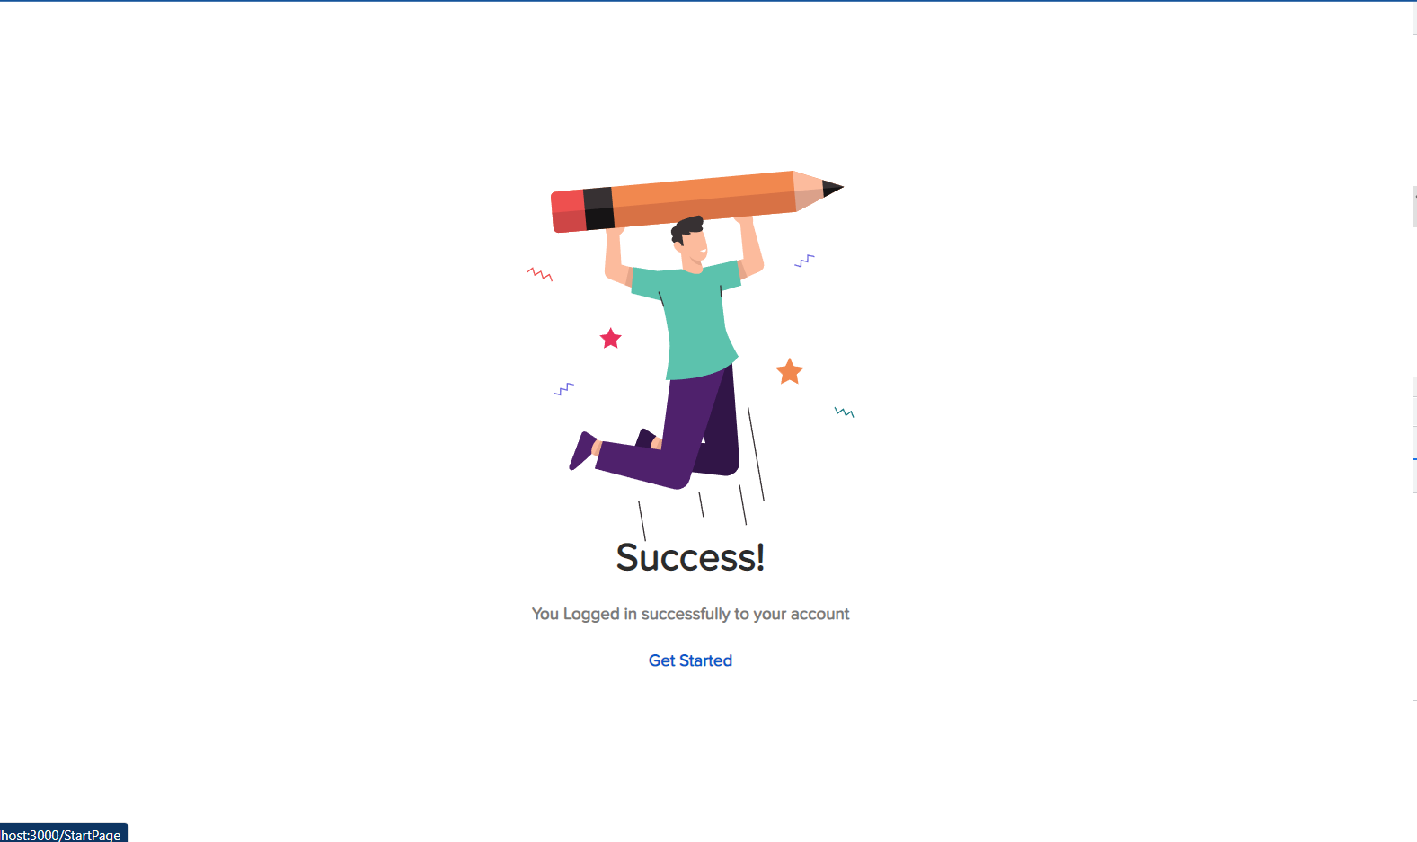
Login Success Page

Slide 14
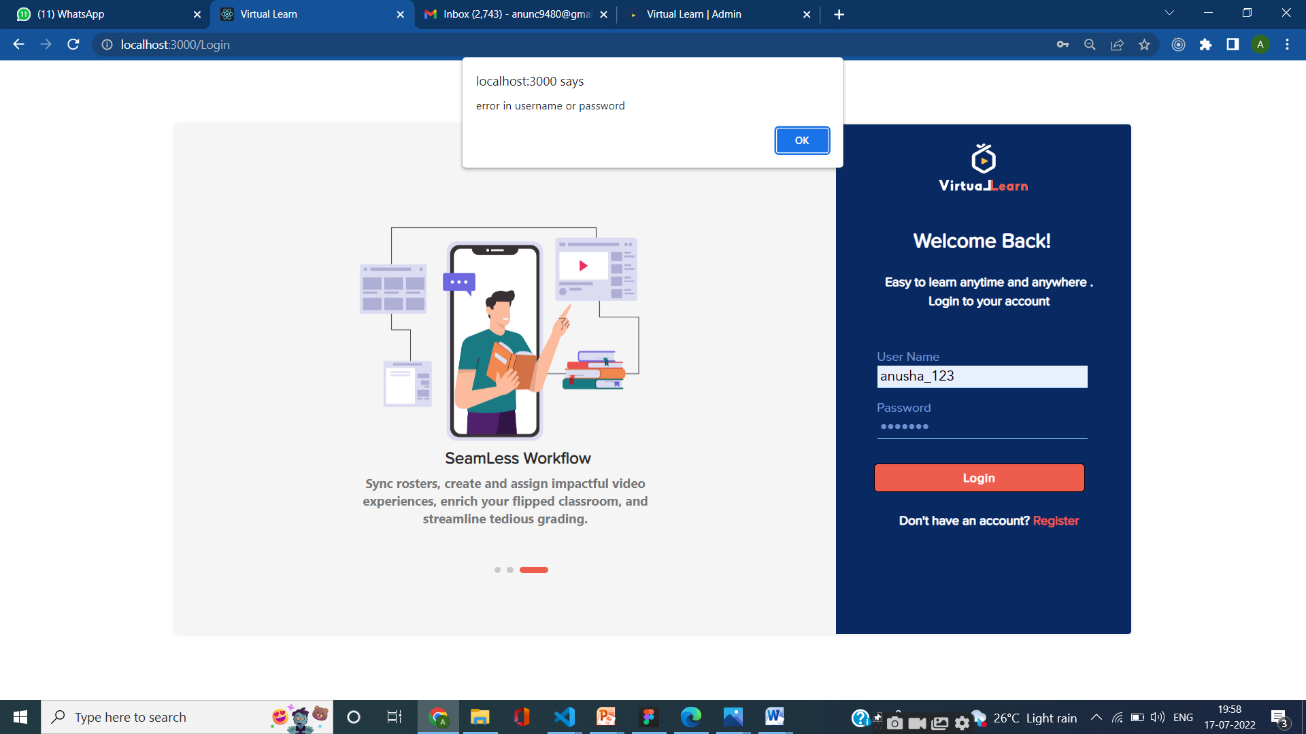
Login error Page

Slide 15
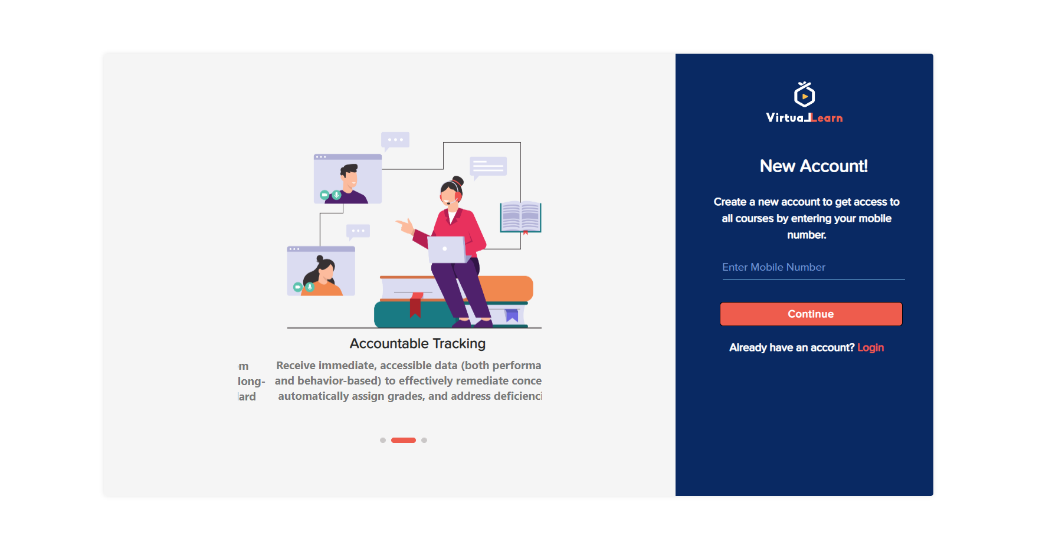
Student Register Page

Slide 16
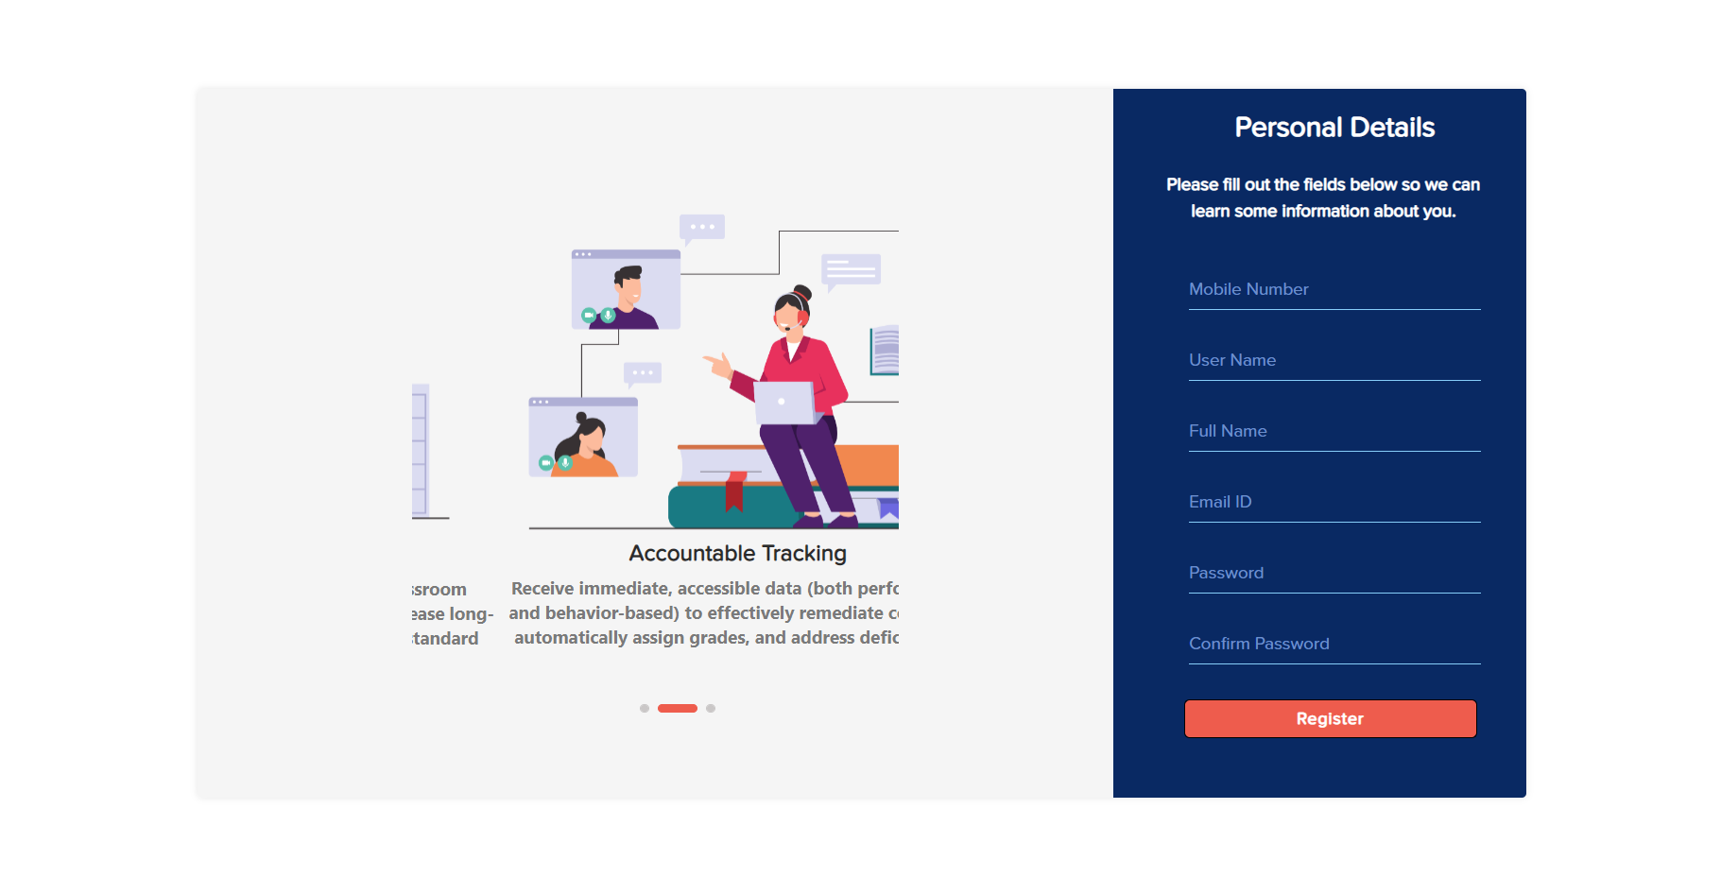

Slide 17
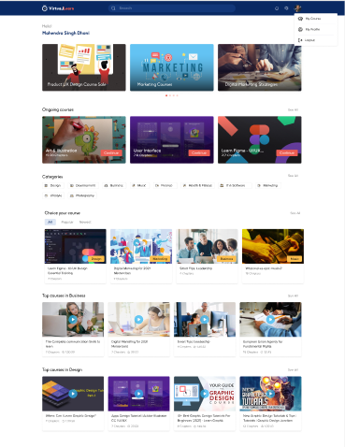
Home Page

Slide 18
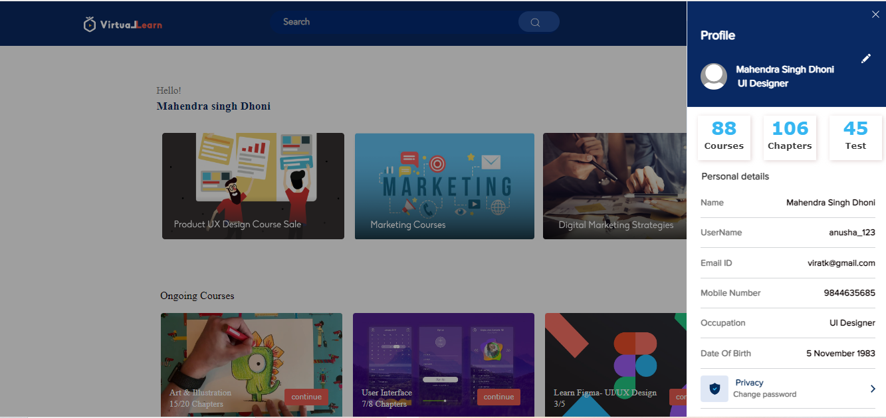
Profile Page

Slide 19
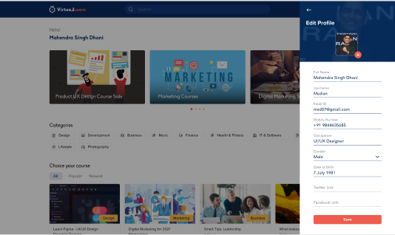
Edit Profile Page

Slide 20
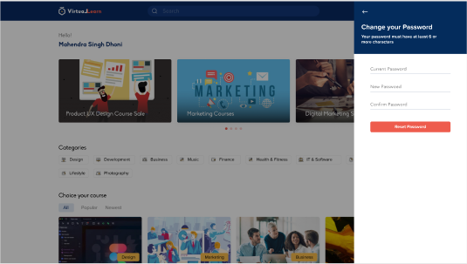
Change password Page

Slide 21
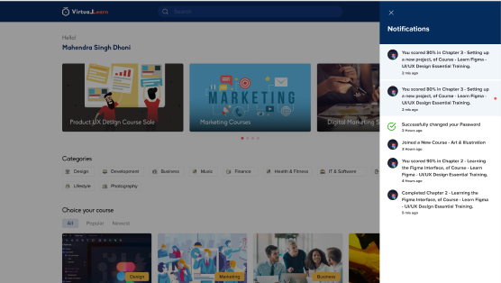
Notification Page

Slide 22

Settings Page

Slide 23

Privacy Policy Page

Slide 24
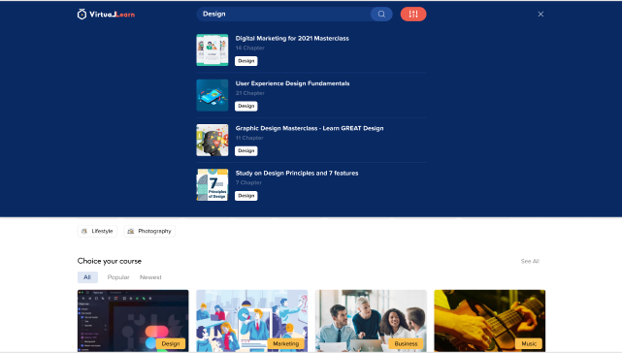
Search Page

Slide 25
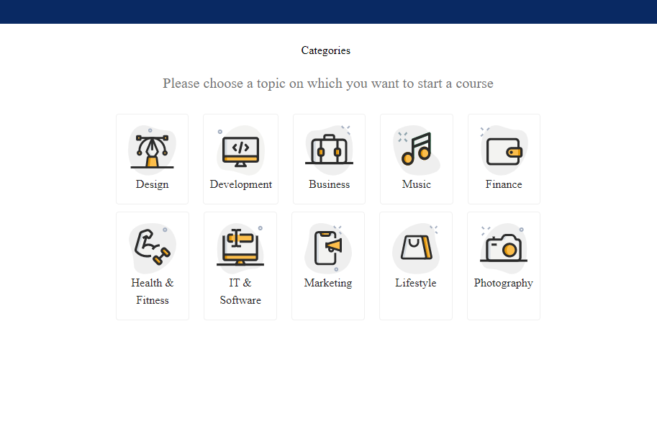
categories Page

Slide 26
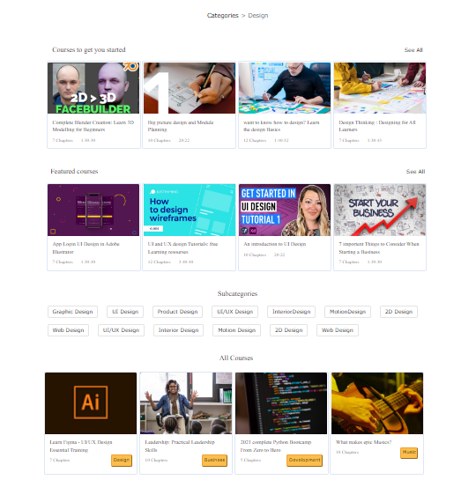
categories Page

Slide 27
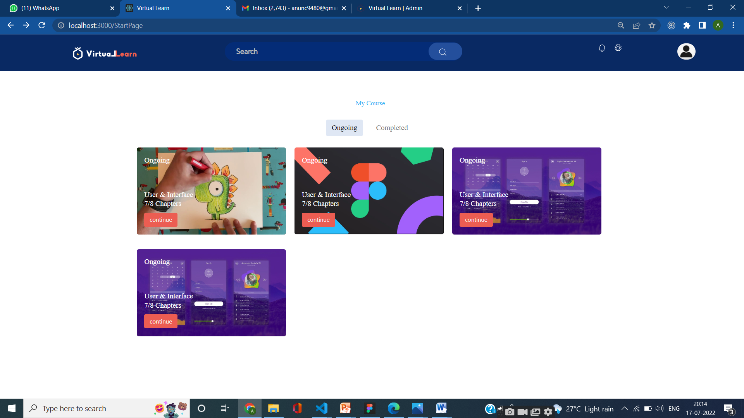
My Course Page

Slide 28
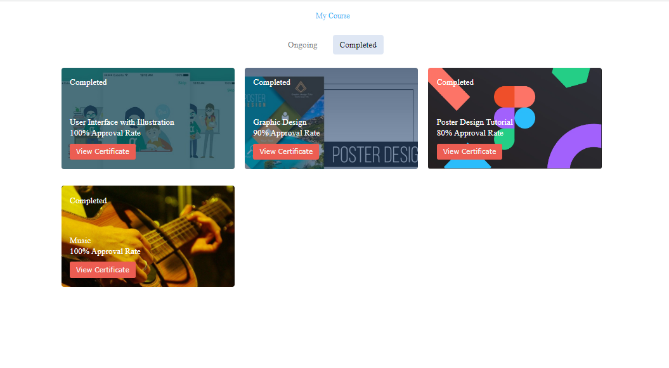
Completed course Page

Slide 29
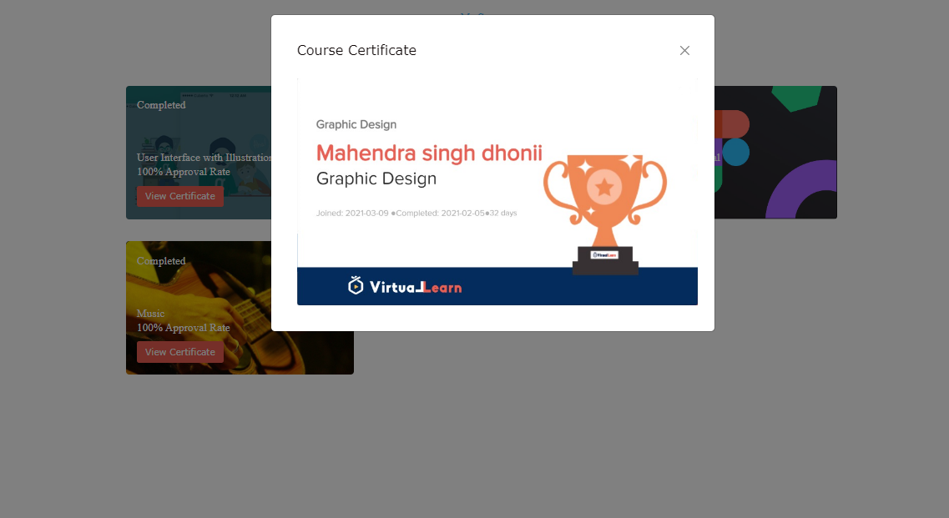
View certificate Page

Slide 30
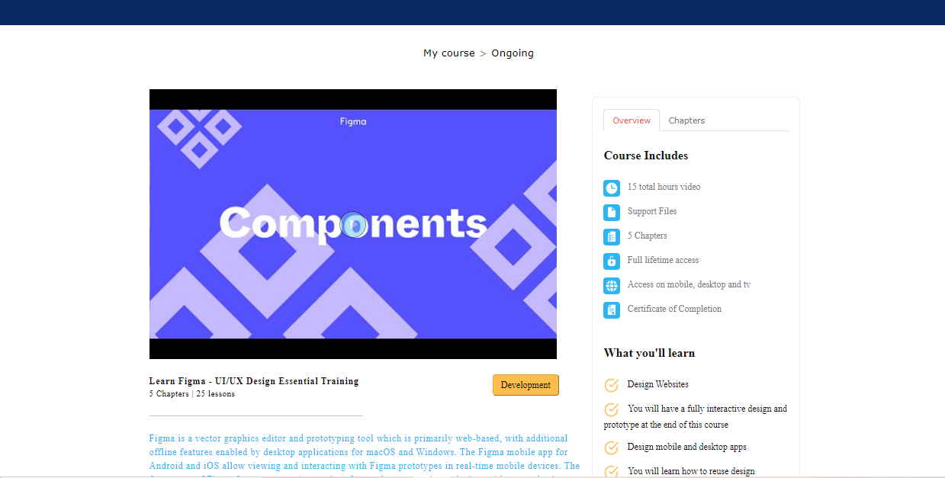
Course Overview Page

Slide 31
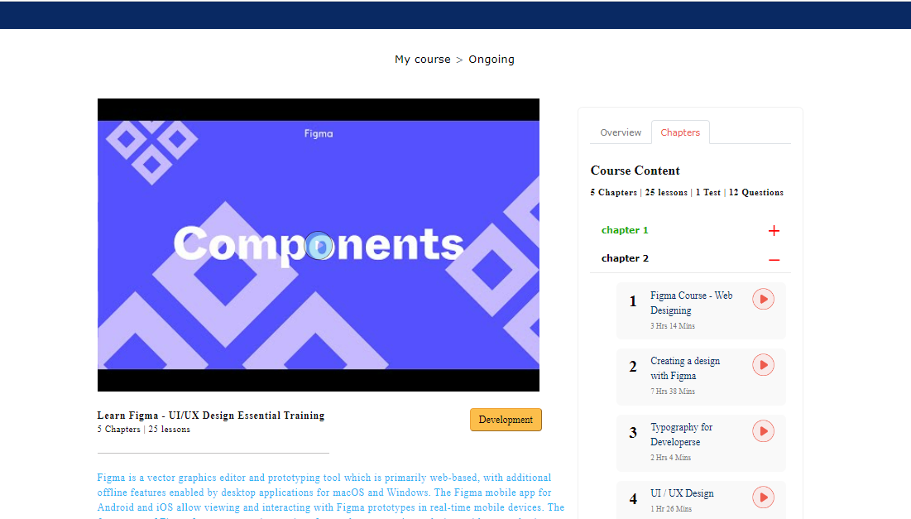
Course chapters Page

Slide 32
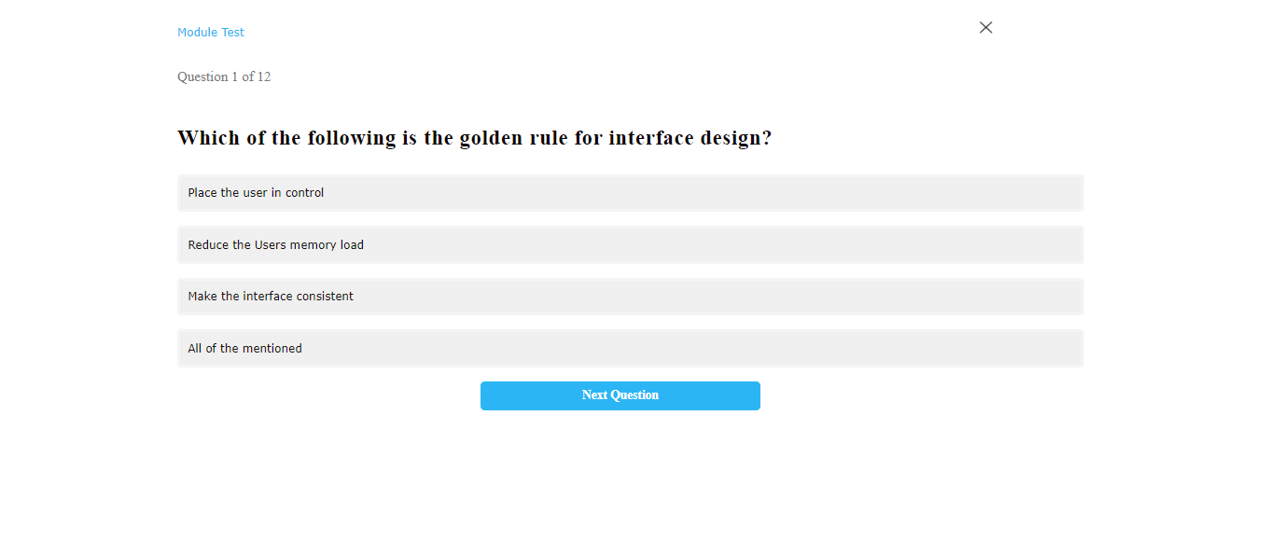
Test Page

Slide 33
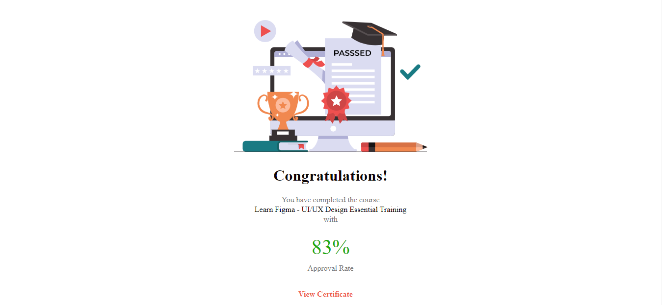
Test Result Page

Slide 34
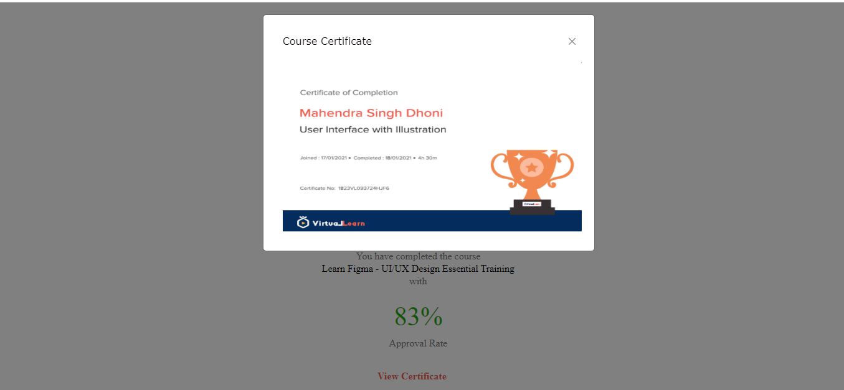
Certificate Page

Slide 35
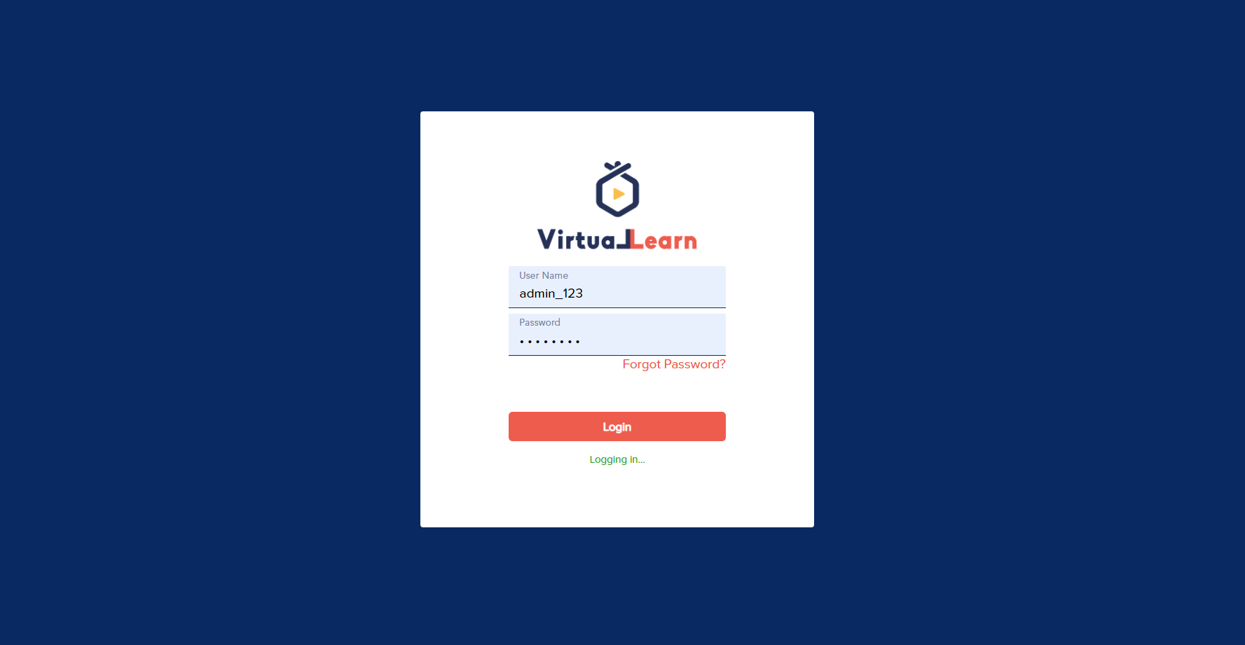
Admin Login Page

Slide 36
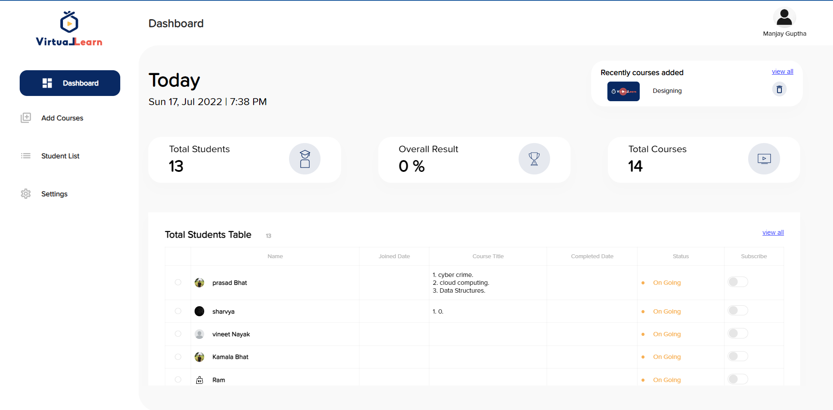
Admin Dashboard

Slide 37
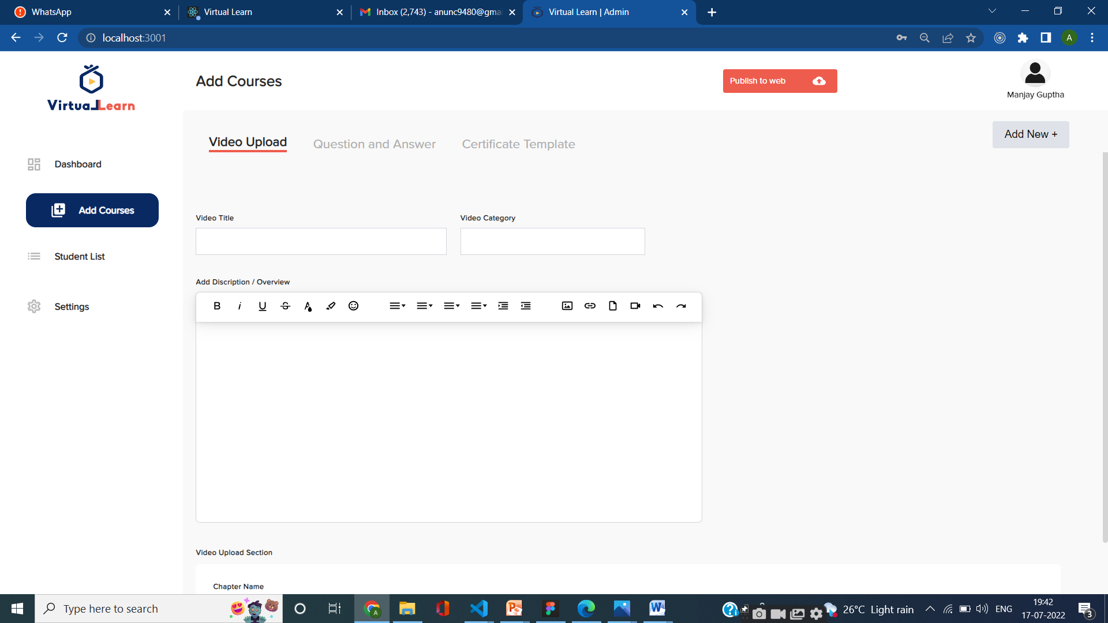
Add courses

Slide 38
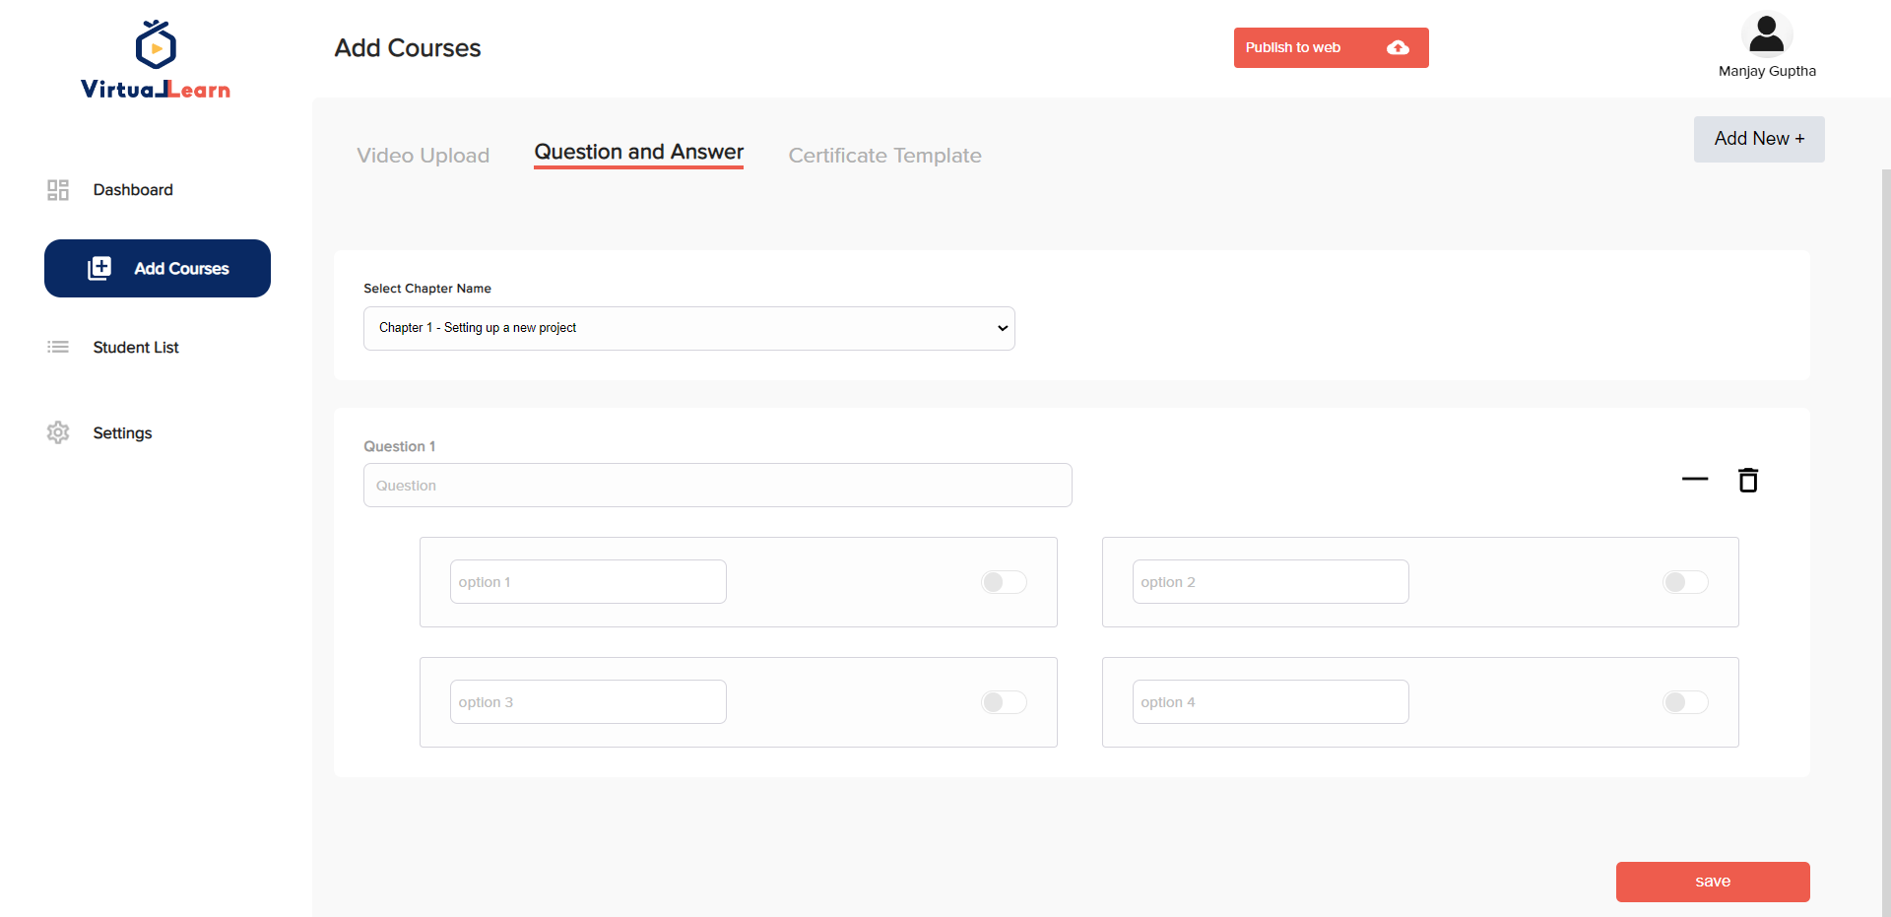
Admin Login Page

Slide 39
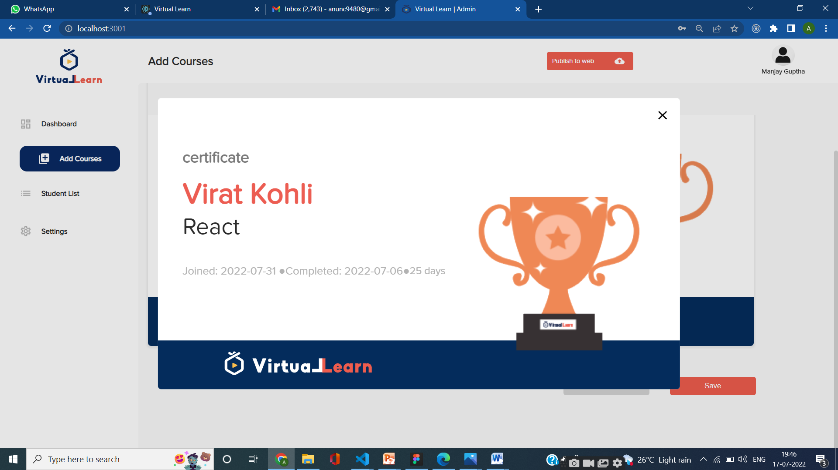
Certificate Page

Slide 40
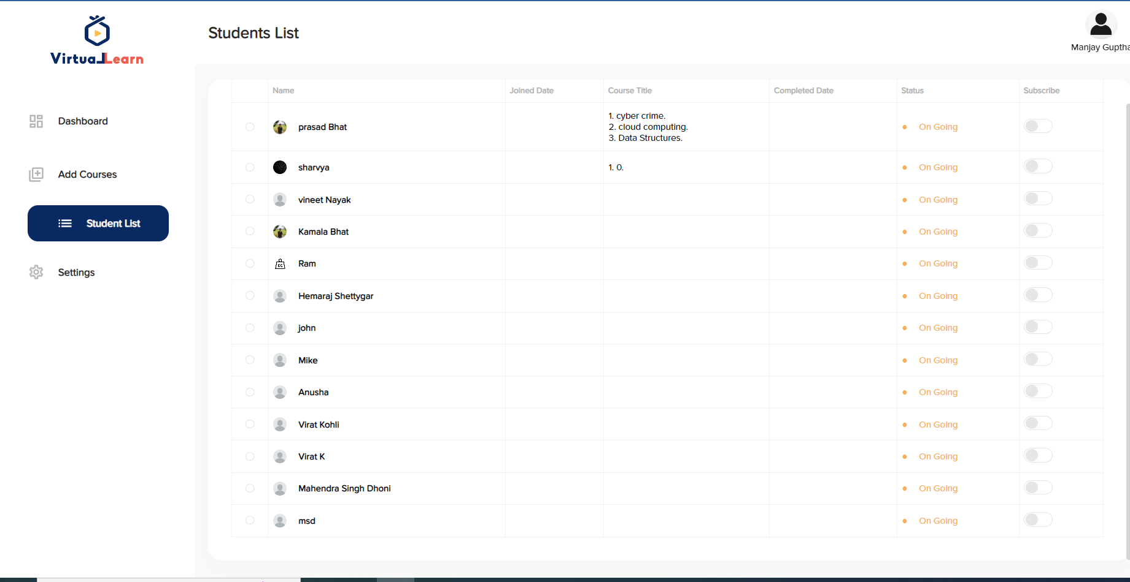
Student List Page

Slide 41
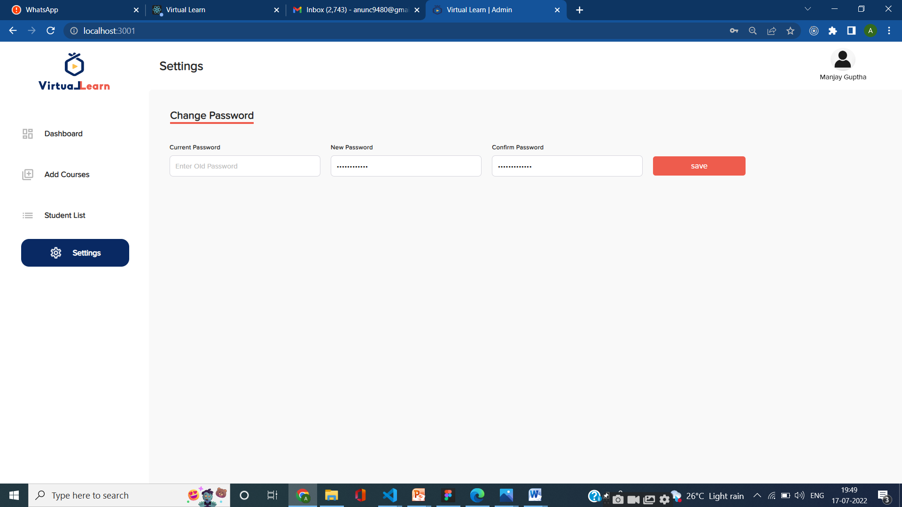
Settings Page

Slide 42
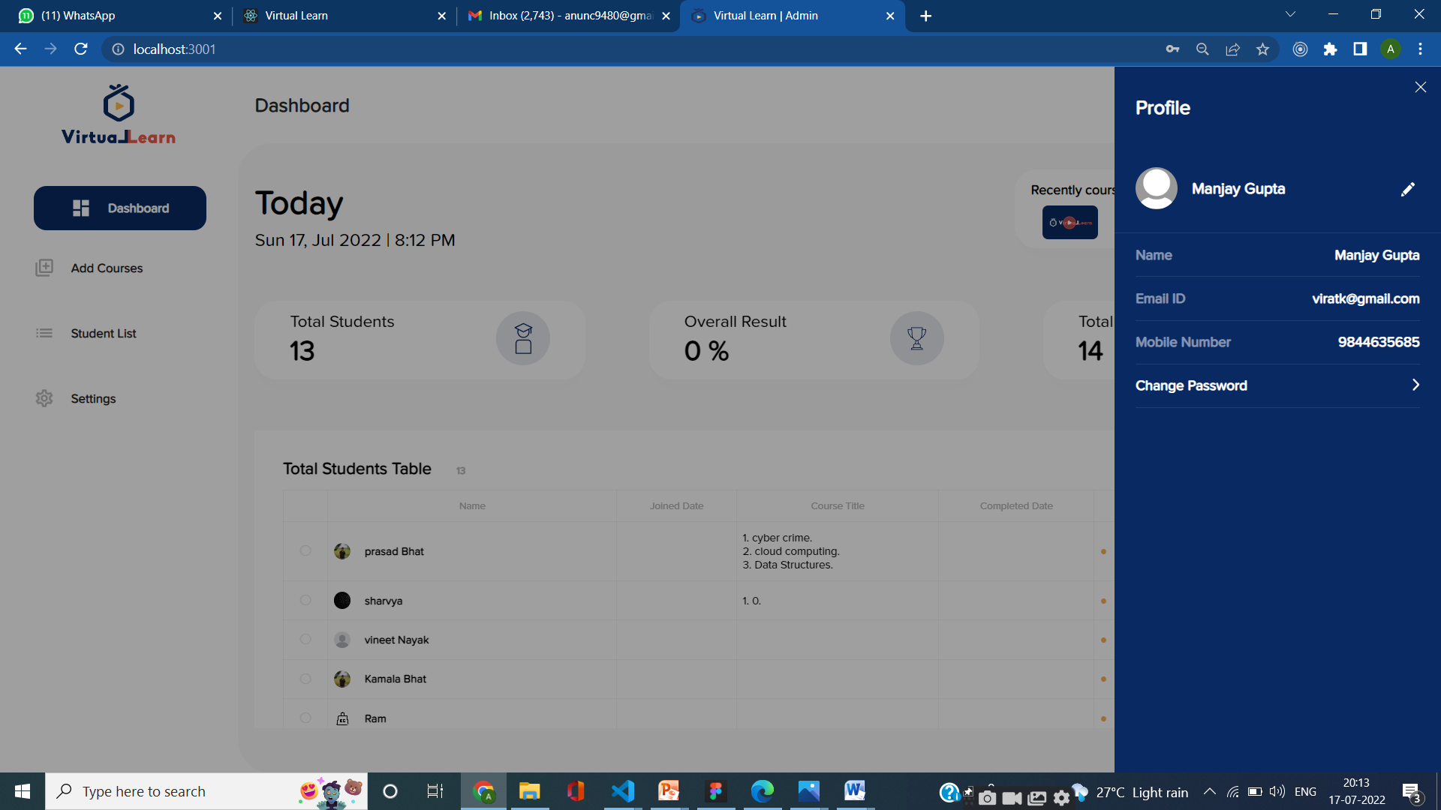
Profile page

Slide 43
Conclusion
The website mainly contains two parts instructor interface and the student interface.
The student interface will allow students to Watch course videos, attempt quizzes and allocation of certificates.
The instructor interface allows the instructor to manage the course videos, and quizzes and track the student involvement in the course.

Slide 44
Future Enhancements
Lectures to upload assignments and resources for their units.
Students to download the resources and upload assignments.
Currently, the live online teaching methods, and live question and answer sessions are not included on the website

